Slide 1


BUS 243
Lecture 4: Discriminative classifiers

Slide 2
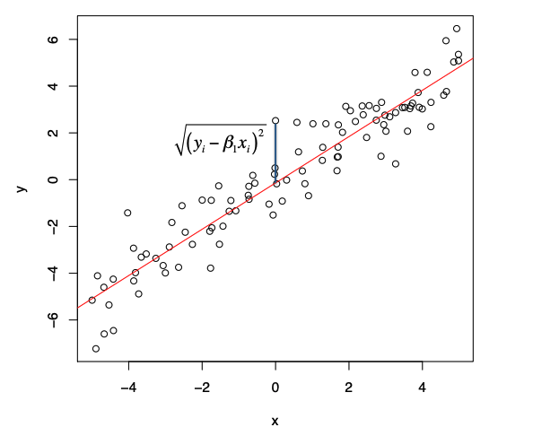
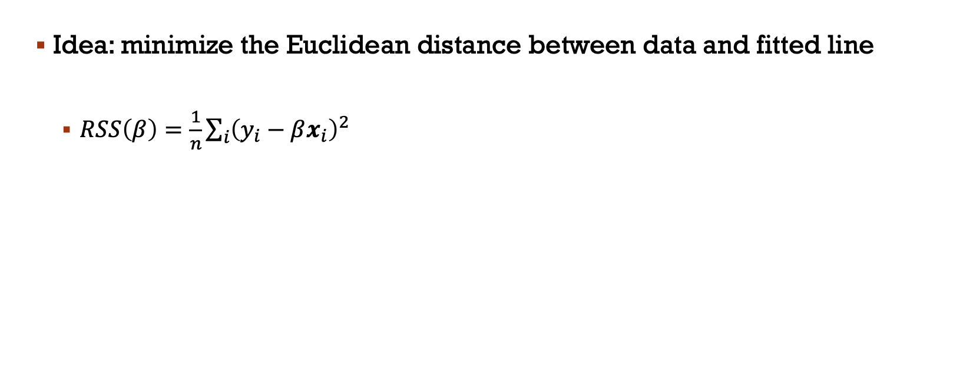
Fitting a Linear Regression
Idea: minimize the Euclidean distance between data and fitted line
$RSS\left(β\right)=\frac{1}{n}\sum_{i}{{\left(y_{i}−βx_{i}\right)}^{2}}$

Slide 3
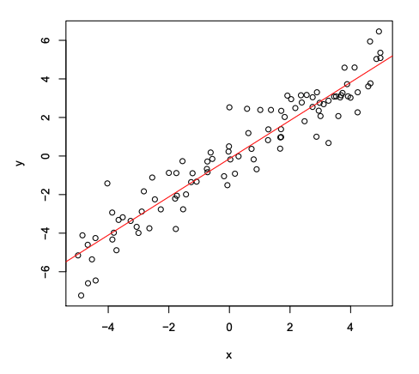
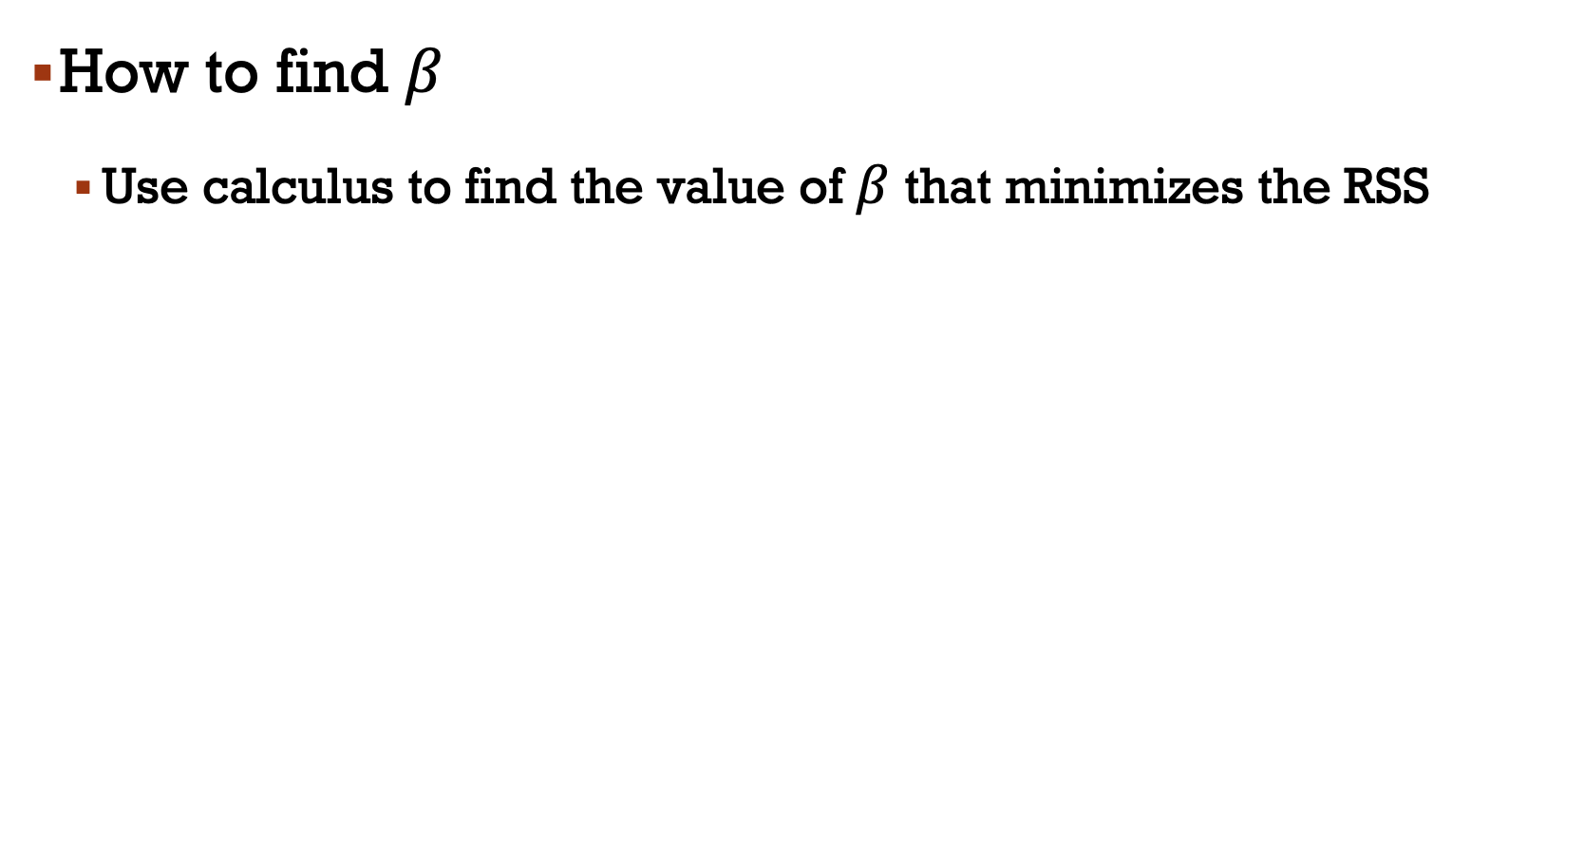
How to find $β$
Use calculus to find the value of $β$ that minimizes the RSS

Slide 4
Probabilistic Interpretation
Our analysis so far has not included any probabilities
Linear regression does have a probabilistic (probability model-based) interpretation

Slide 5
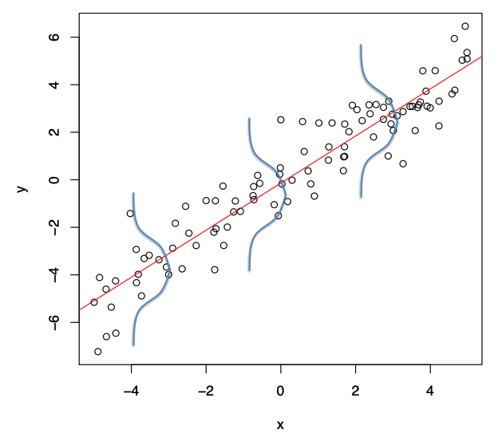
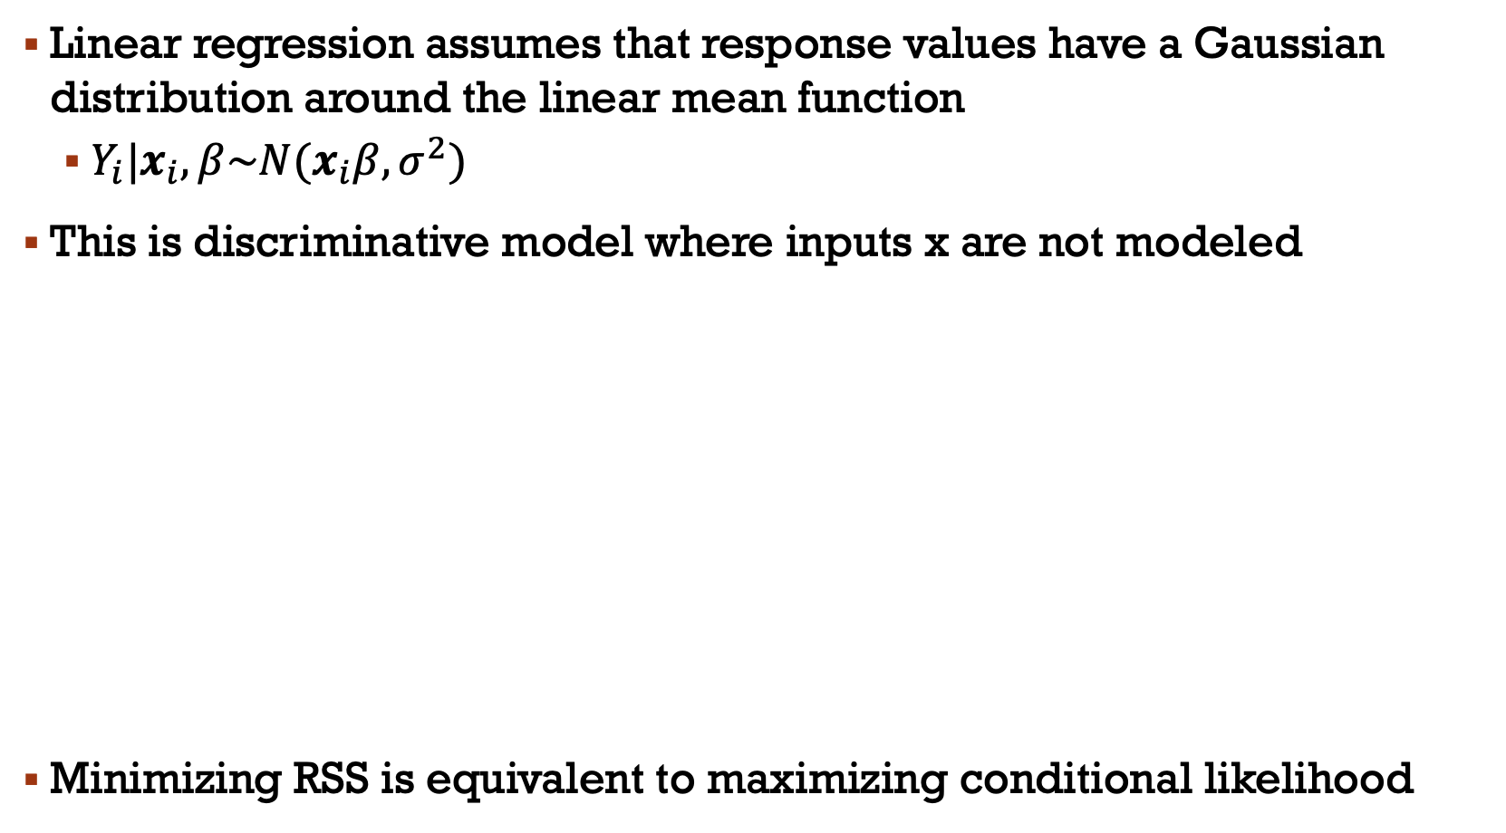
Linear regression assumes that response values have a Gaussian distribution around the linear mean function
$Y_{i}|x_{i},β\sim N(x_{i}β,σ^{2})$
This is discriminative model where inputs x are not modeled
Minimizing RSS is equivalent to maximizing conditional likelihood

Slide 6
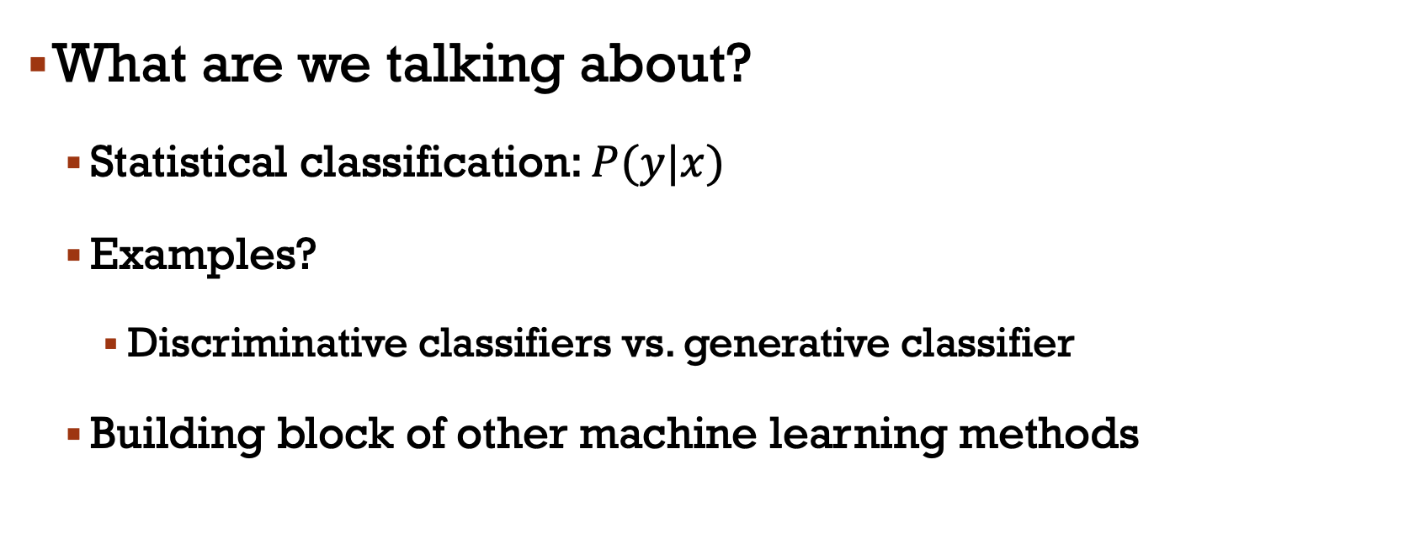
Classification: Logistic Regression
What are we talking about?
Statistical classification: $P(y|x)$
Examples?
Discriminative classifiers vs. generative classifier
Building block of other machine learning methods

Slide 7

Generative and Discriminative Classifiers
Suppose we’re distinguishing cat from dog images

Slide 8

Generative Classifier
Build a model of what's in a cat image
Knows about whiskers, ears, eyes
Assigns a probability to any image: how cat-y is this image?
Also build a model for dog images
Now given a new image
Run both models and see which one fits better

Slide 9
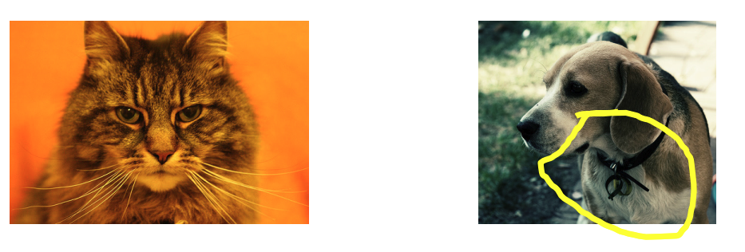
Discriminative classifier
Just try to distinguish dogs from cats
Oh, look. Dogs have collars! Let’s ignore everything else

Slide 10
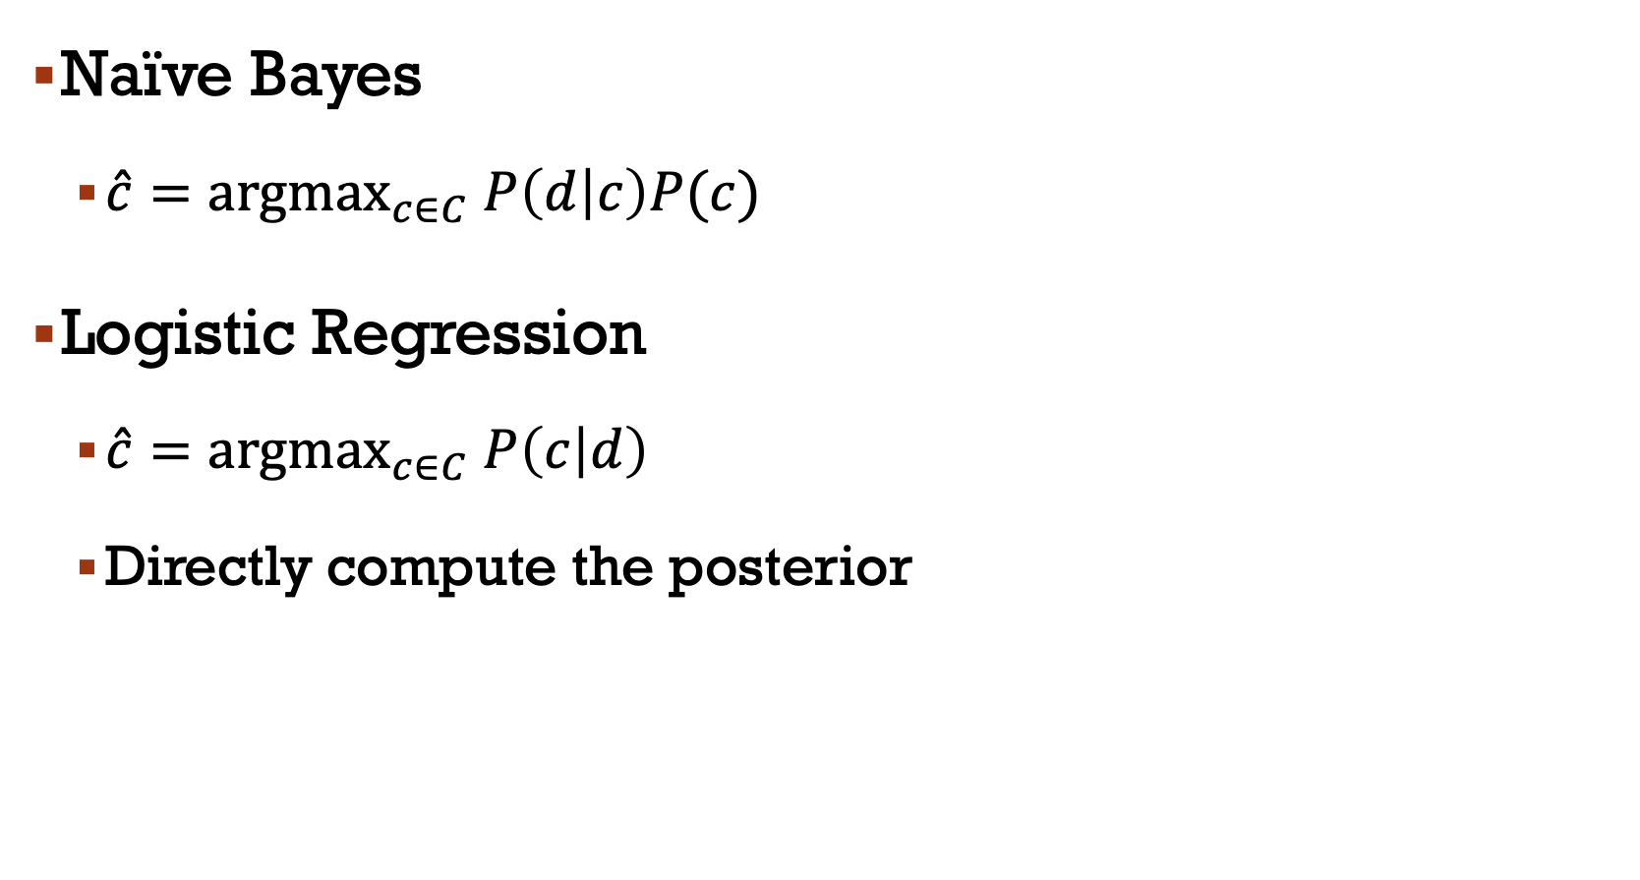
Naïve Bayes
$\hat{c}={argmax}_{c∈C} P\left(d | c\right)P(c)$
Logistic Regression
$\hat{c}={argmax}_{c∈C} P\left(c | d\right)$
Directly compute the posterior

Slide 11
Logistic regression
Discriminative classifiers learn what features from the input are most useful to discriminate between the different possible classes!
Train a classifier that can make a binary decision about the class of a new input
To create a probability, we need to transform!

Slide 12
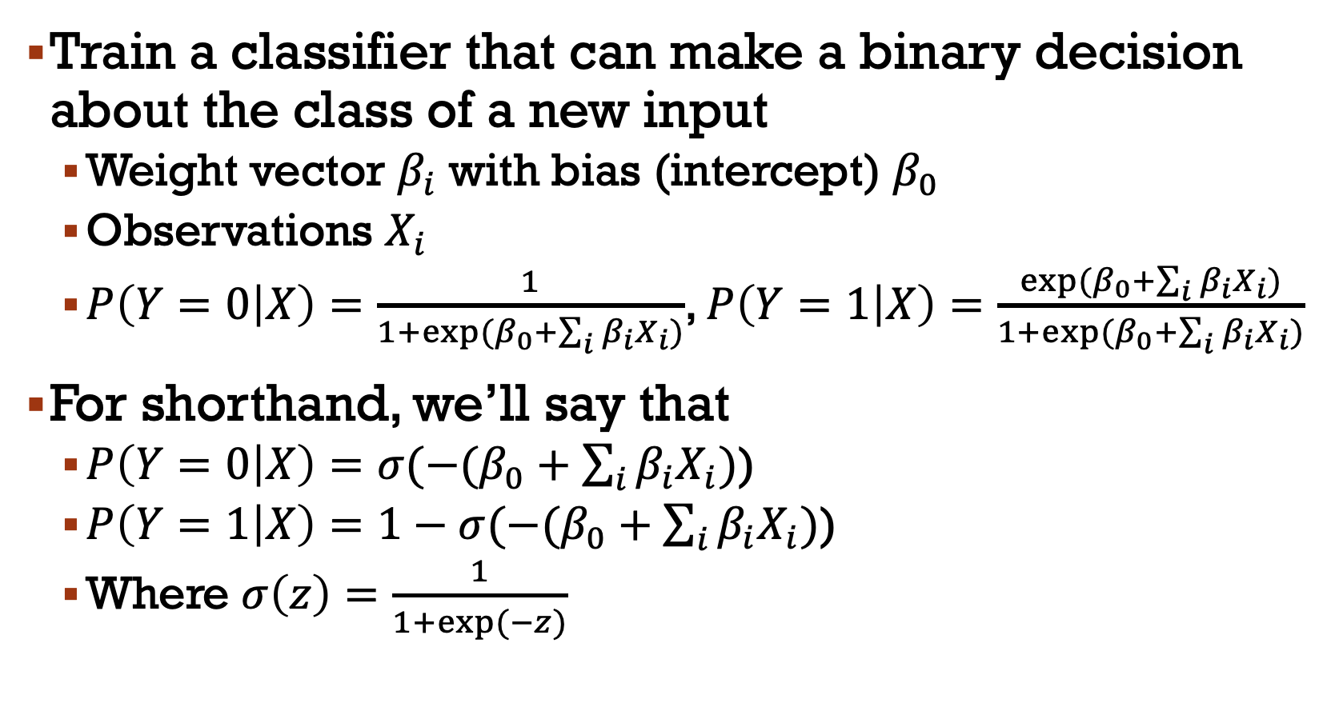
Train a classifier that can make a binary decision about the class of a new input
Weight vector $β_{i}$ with bias (intercept) $β_{0}$
Observations $X_{i}$
$P\left(Y=0 | X\right)=\frac{1}{1+\exp{(β_{0}+\sum_{i}{β_{i}X_{i})}}}$, $P\left(Y=1 | X\right)=\frac{\exp{(β_{0}+\sum_{i}{β_{i}X_{i})}}}{1+\exp{(β_{0}+\sum_{i}{β_{i}X_{i})}}}$
For shorthand, we’ll say that
$P\left(Y=0 | X\right)=σ(−(β_{0}+\sum_{i}{β_{i}X_{i})}$)
$P\left(Y=1 | X\right)=1−σ(−(β_{0}+\sum_{i}{β_{i}X_{i})}$)
Where $σ\left(z\right)=\frac{1}{1+\exp{(−z)}}$

Slide 13
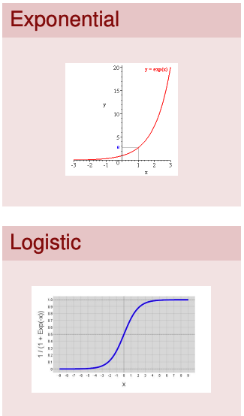
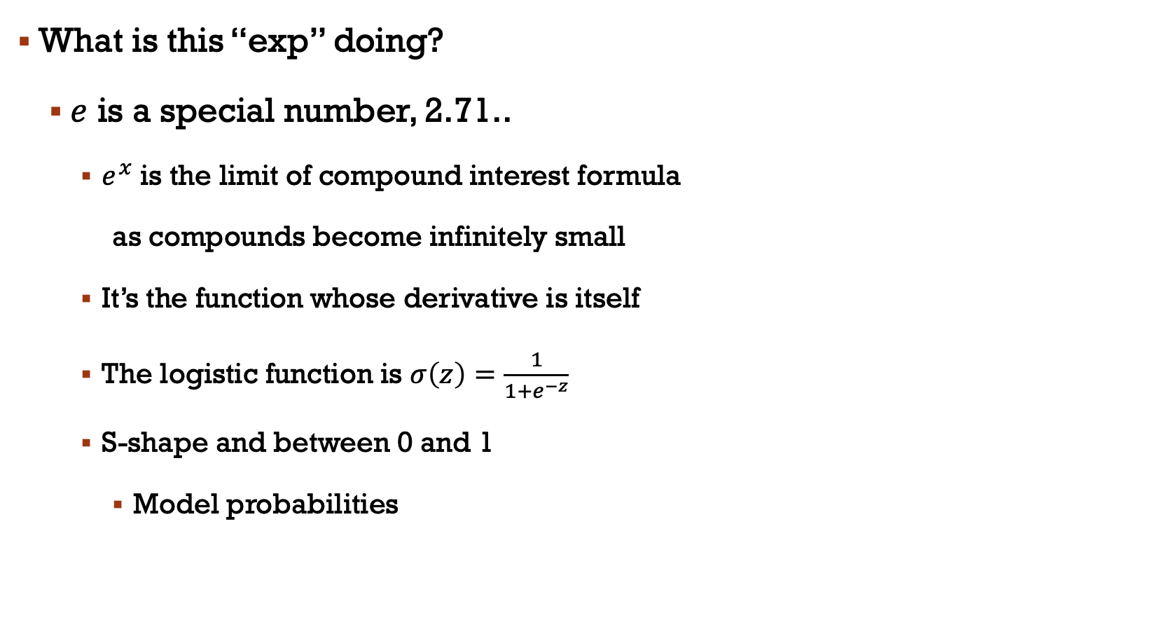
What is this “exp” doing?
$e$ is a special number, 2.71..
$e^{x}$ is the limit of compound interest formula
as compounds become infinitely small
It’s the function whose derivative is itself
The logistic function is $σ\left(z\right)=\frac{1}{1+e^{−z}}$
S-shape and between 0 and 1
Model probabilities

Slide 14
Sentiment example: Y=1 or Y=0?
It's hokey . There are virtually no surprises , and the writing is second-rate . So why was it so enjoyable ? For one thing , the cast is great . Another nice touch is the music . I was overcome with the urge to get off the couch and start dancing . It sucked me in , and it'll do the same to you .

Slide 15
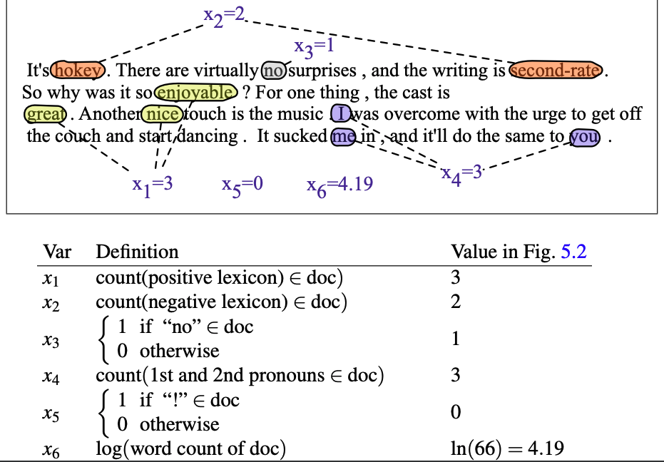

Slide 16
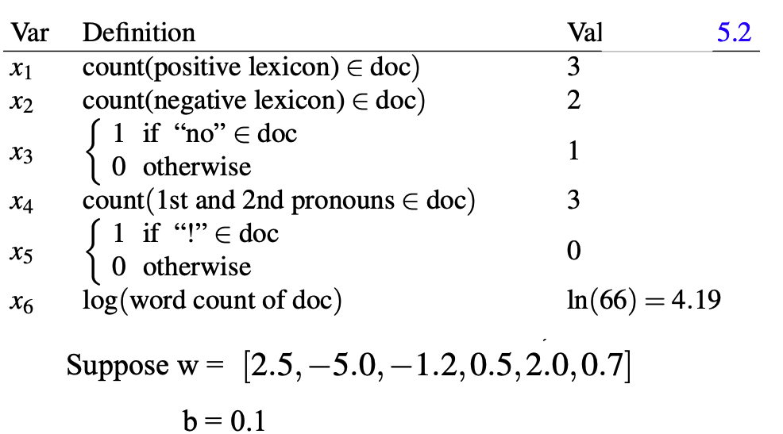

Slide 17
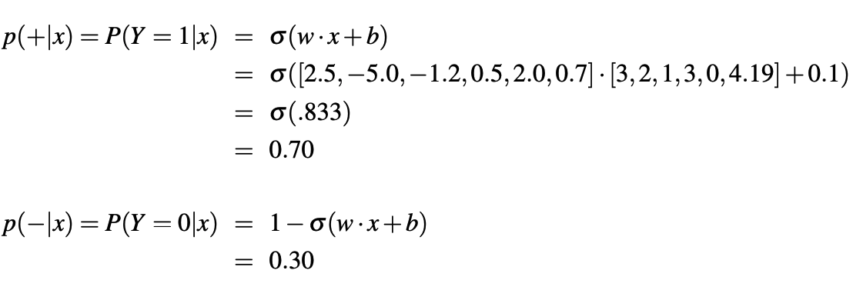

Slide 18
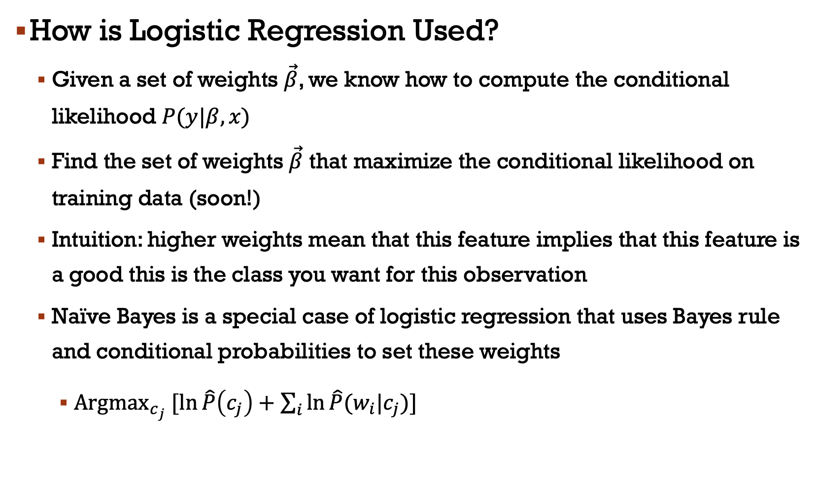
How is Logistic Regression Used?
Given a set of weights $\vec{β}$, we know how to compute the conditional likelihood $P(y|β,x)$
Find the set of weights $\vec{β}$ that maximize the conditional likelihood on training data (soon!)
Intuition: higher weights mean that this feature implies that this feature is a good this is the class you want for this observation
Naïve Bayes is a special case of logistic regression that uses Bayes rule and conditional probabilities to set these weights
${Argmax}_{c_{j}} [\ln{\hat{P}\left(c_{j}\right)+\sum_{i}{\ln{\hat{P}(w_{i}|c_{j})}}}]$

Slide 19
Contrasting Naïve Bayes and Logistic Regression
Naïve Bayes easier
Naïve Bayes better on smaller datasets
Logistic regression better on medium-sized datasets
On huge datasets, it does not really matter (data always win)
Optional reading by Ng and Jordan has proofs and experiments
Logistic regression allows arbitrary features (biggest difference!)
Don’t need to memorize (or work through) previous slide - just understand that naïve Bayes is a special case of logistic regresion

Slide 20
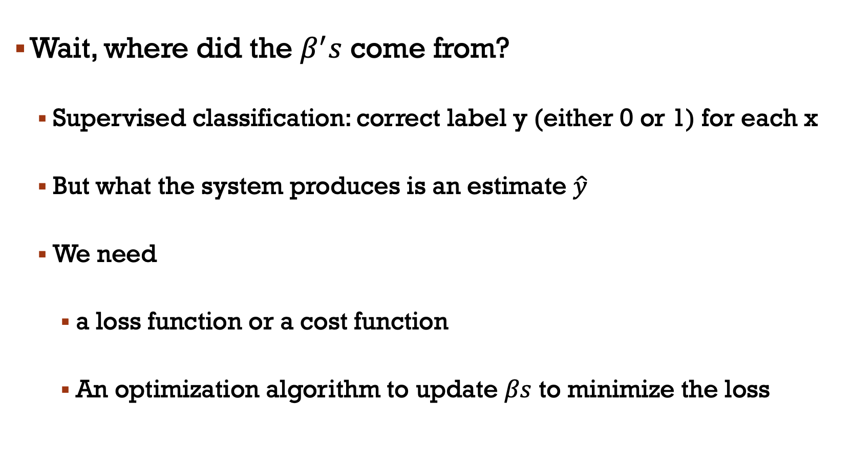
Wait, where did the $β^{′}s$ come from?
Supervised classification: correct label y (either 0 or 1) for each x
But what the system produces is an estimate $\hat{y}$
We need
a loss function or a cost function
An optimization algorithm to update $βs$ to minimize the loss

Slide 21
A loss function
Cross-entropy loss
An optimization algorithm
Stochastic gradient descent

Slide 22
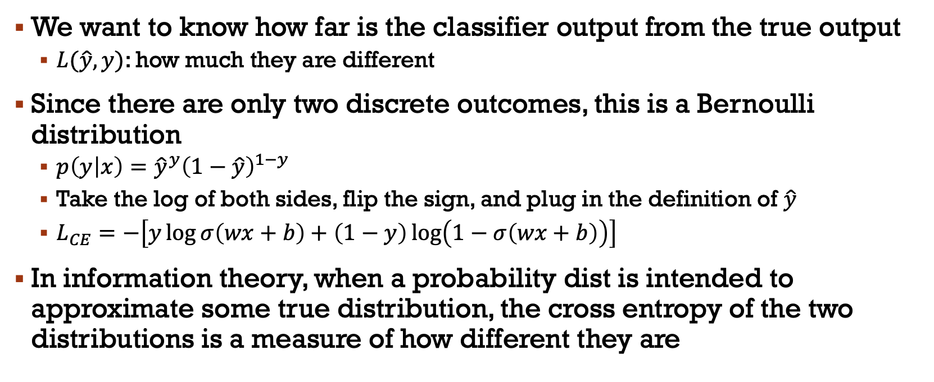
Loss function
We want to know how far is the classifier output from the true output
$L(\hat{y},y)$: how much they are different
Since there are only two discrete outcomes, this is a Bernoulli distribution
$p\left(y | x\right)={\hat{y}}^{y}{\left(1−\hat{y}\right)}^{1−y}$
Take the log of both sides, flip the sign, and plug in the definition of $\hat{y}$
$L_{CE}=−\left[y\log{σ\left(wx+b\right)+\left(1−y\right)\log\left(1−σ\left(wx+b\right)\right)}\right]$
In information theory, when a probability dist is intended to approximate some true distribution, the cross entropy of the two distributions is a measure of how different they are

Slide 23
Let’s see if this works for our sentiment example
We want loss to be
Smaller if the model estimate is closed to correct
Bigger if model is confused
Let’s first suppose the true label of this is y=1 (positive)
It's hokey . There are virtually no surprises , and the writing is second-rate . So why was it so enjoyable ? For one thing , the cast is great . Another nice touch is the music . I was overcome with the urge to get off the couch and start dancing . It sucked me in , and it'll do the same to you .

Slide 24
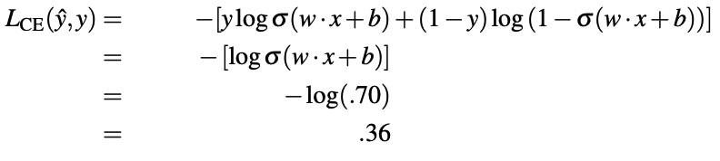
True value is y=1. How well is our model doing?
What’s the loss?

Slide 25
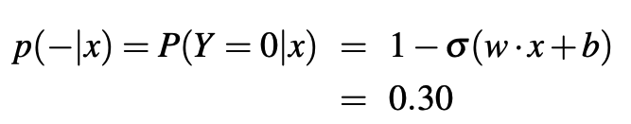
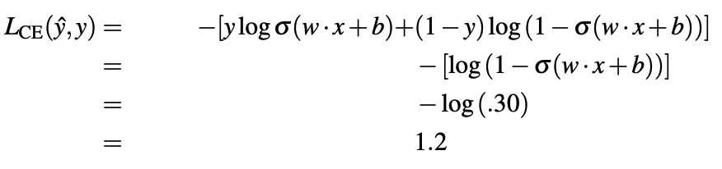
Suppose true value instead was y=0
What’s the loss?
Sure enough, loss was bigger when model was wrong!

Slide 26
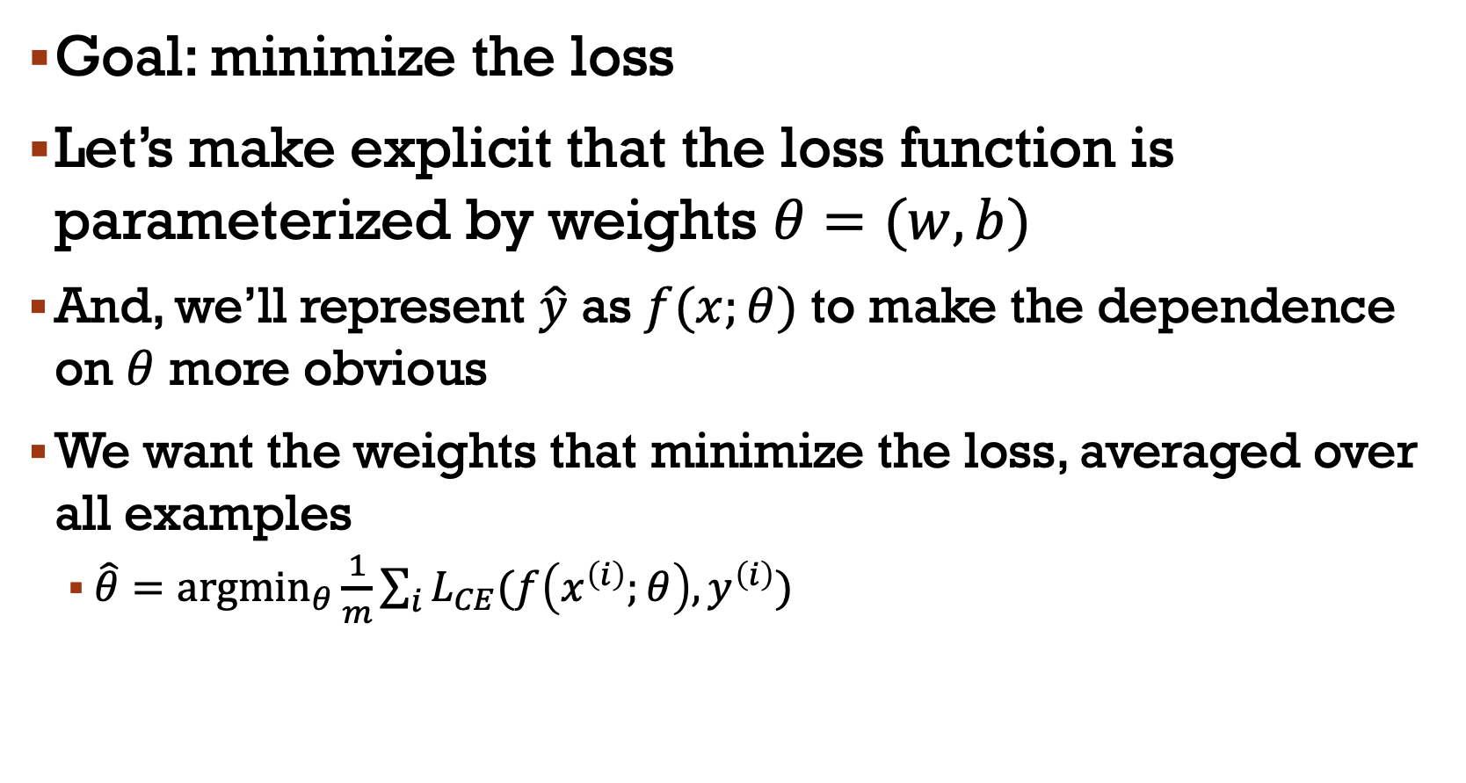
Goal: minimize the loss
Let’s make explicit that the loss function is parameterized by weights $θ=(w,b)$
And, we’ll represent $\hat{y}$ as $f(x;θ)$ to make the dependence on $θ$ more obvious
We want the weights that minimize the loss, averaged over all examples
$\hat{θ}={argmin}_{θ}\frac{1}{m}\sum_{i}{L_{CE}(f\left(x^{\left(i\right)};θ\right),y^{\left(i\right)})}$

Slide 27
For logistic regression, loss function is convex
A convex function has just one minimum
Gradient descent starting from any point is guaranteed to find the minimum

Slide 28
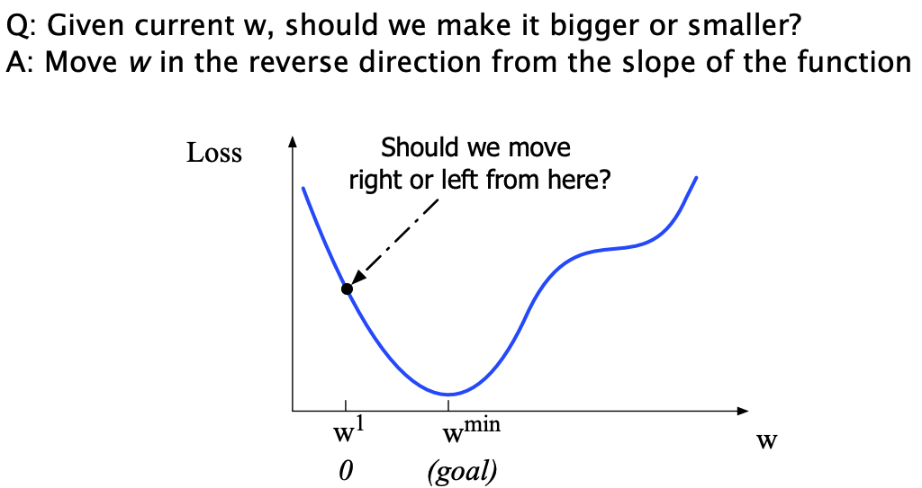

Slide 29
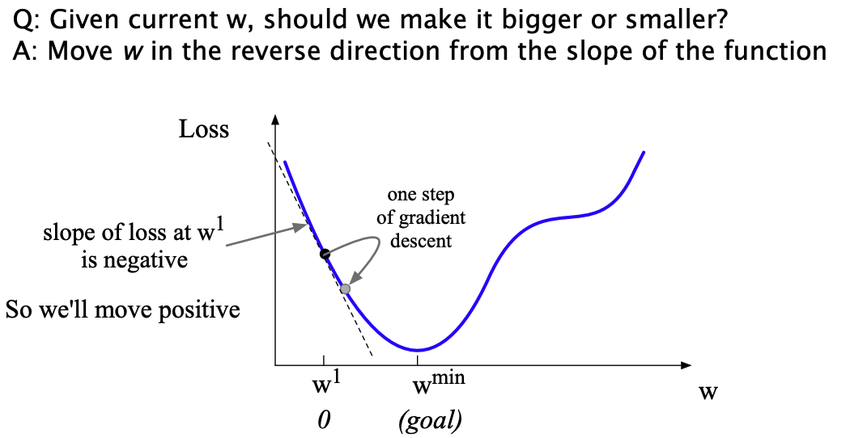

Slide 30
The gradient of a function of many variables is a vector pointing in the direction of the greatest increase in a function
Gradient Descent
Find the gradient of the loss function at the current point and move in the opposite direction

Slide 31
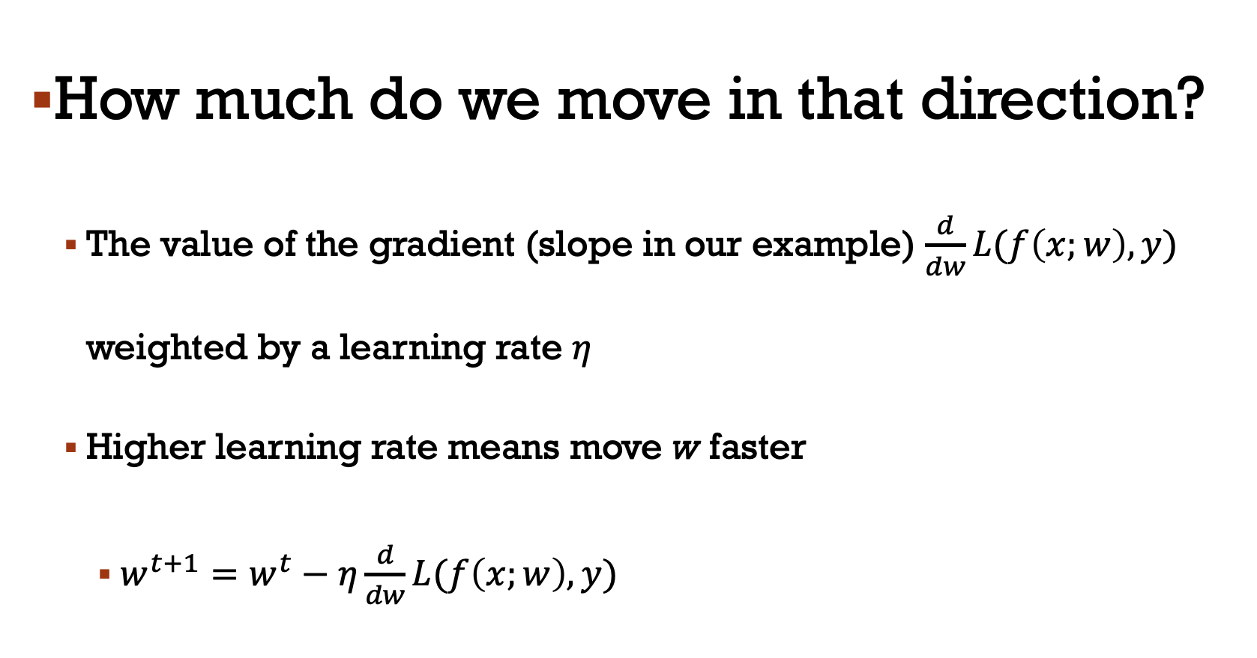
How much do we move in that direction?
The value of the gradient (slope in our example) $\frac{d}{dw}L(f\left(x;w\right),y)$ weighted by a learning rate $η$
Higher learning rate means move w faster
$w^{t+1}=w^{t}−η\frac{d}{dw}L(f\left(x;w\right),y)$

Slide 32
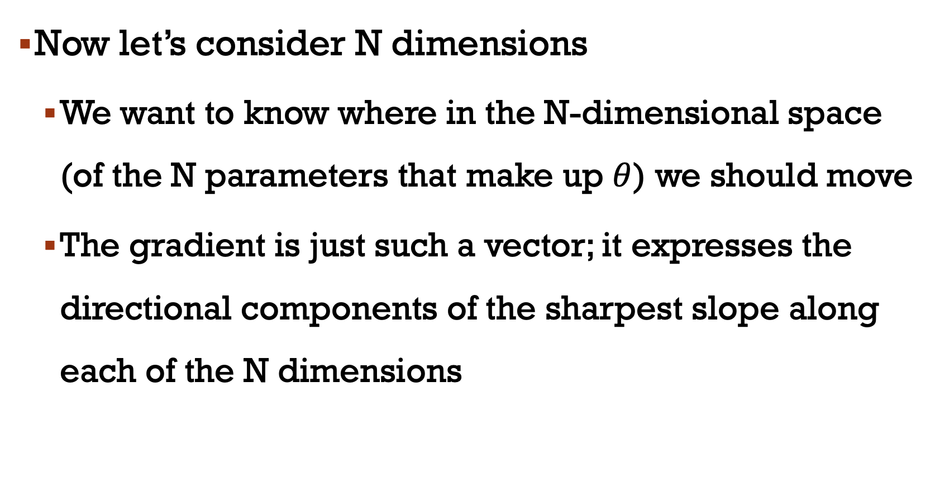
Now let’s consider N dimensions
We want to know where in the N-dimensional space (of the N parameters that make up $θ$) we should move
The gradient is just such a vector; it expresses the directional components of the sharpest slope along each of the N dimensions

Slide 33
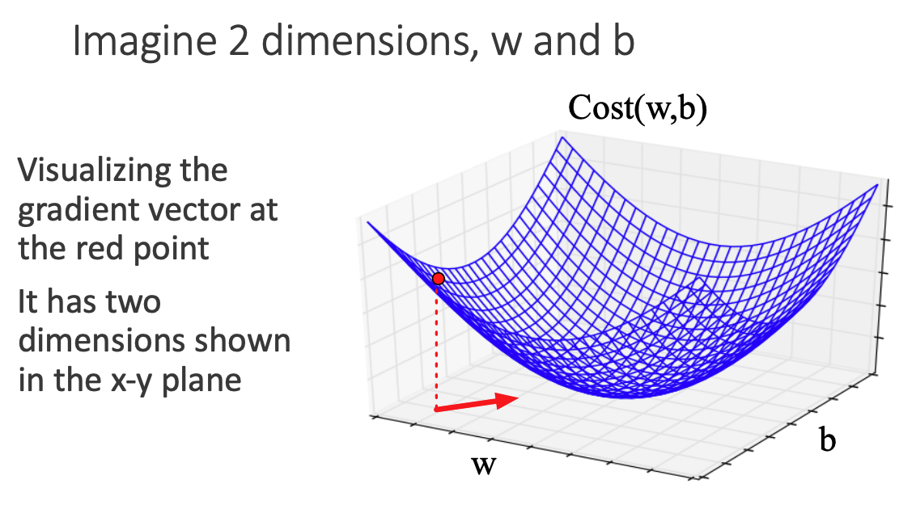

Slide 34
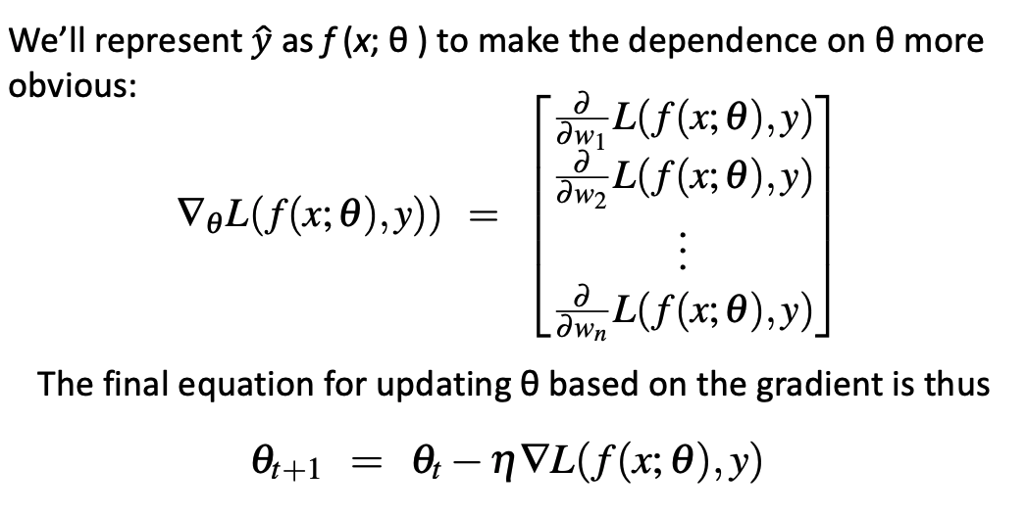

Slide 35
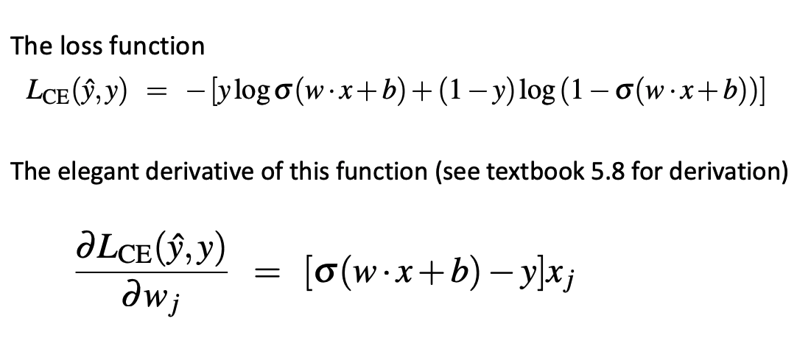

Slide 36
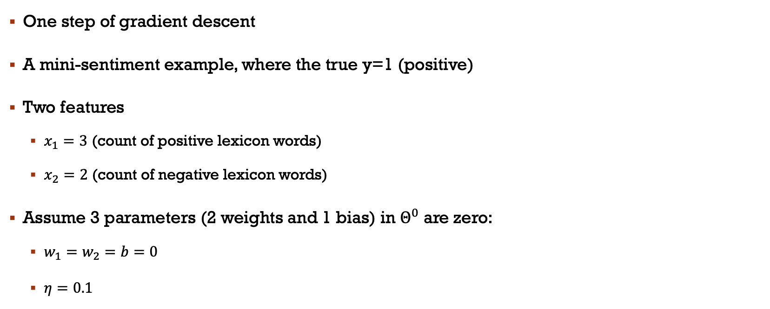
Example
One step of gradient descent
A mini-sentiment example, where the true y=1 (positive)
Two features
$x_{1}=3$ (count of positive lexicon words)
$x_{2}=2$ (count of negative lexicon words)
Assume 3 parameters (2 weights and 1 bias) in $Θ^{0}$ are zero:
$w_{1}=w_{2}=b=0$
$η=0.1$

Slide 37
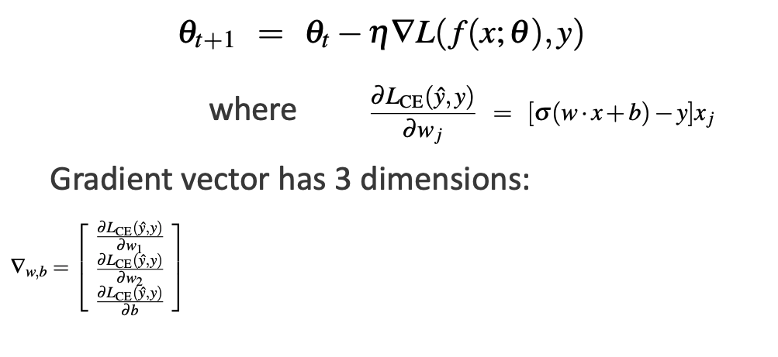

Update step for update $θ$ is:

Slide 38
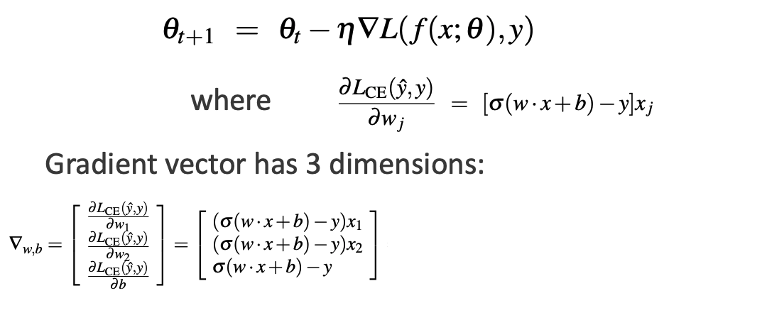
Update step for update $θ$ is:

Slide 39
Update step for update $θ$ is:

Slide 40
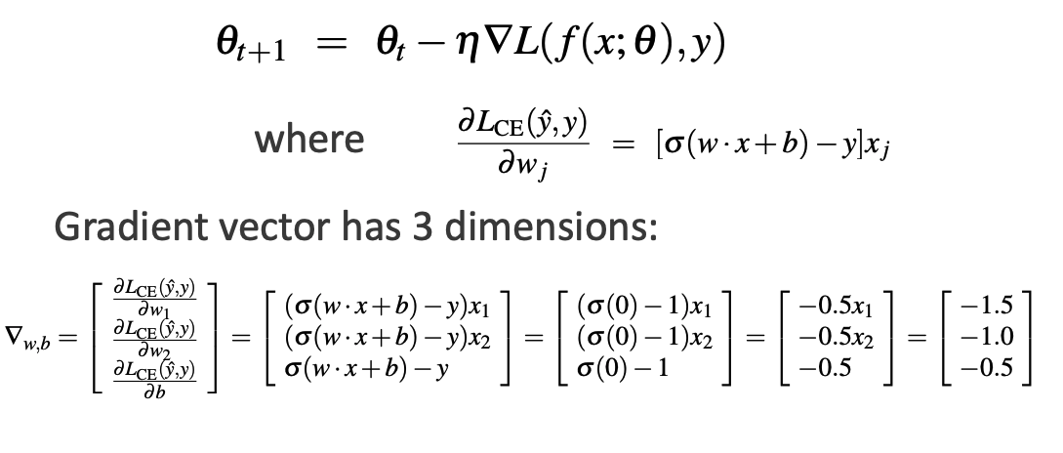
Update step for update $θ$ is:

Slide 41
